Slide 1
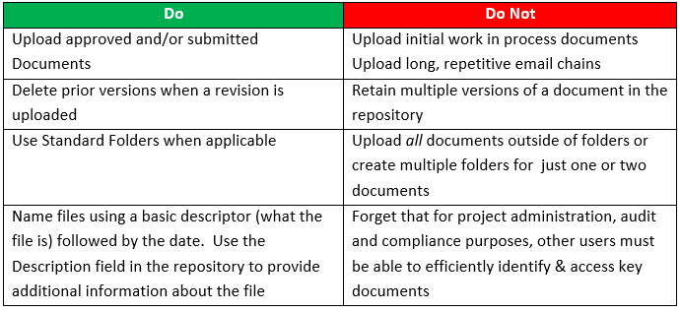
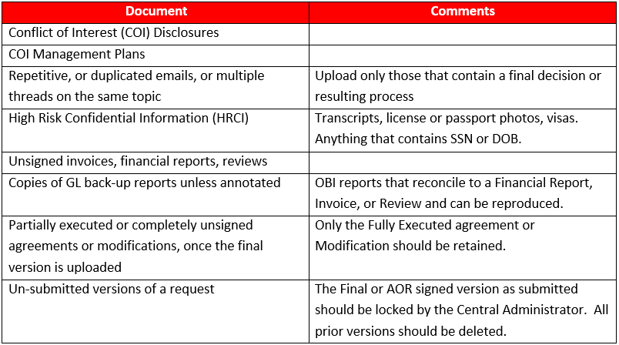
Guidelines at a Glance
Dos & Don’ts
Documents that should not be uploaded
Use the Description Field!

