Slide 1
ecrt (Effort Certification and Reporting Tool) Basics
Financial Administration/Center for Workplace Development
Notes:
Welcome and Introductions.
Thank you all for coming.
My name is … I work for the ….
Talk about the evaluation at end of course that is bookmarked. Sign in sheet. We will take questions throughout the training and at various points.
Meredith Sablosky – Sponsored Effort Reporting Coordinator

Slide 2
Topics
Overview
Effort and Compliance Requirements
Current Effort Reporting Lifecycle
Overview of ecrt and the New Effort Reporting Lifecycle
Important Information for Transitioning to ecrt
Terms and Definitions
Policy Overview
Introduction to ecrt for Effort Certification
Roles and Responsibilities
Tasks and Workflow by Role
Troubleshooting and Method for Adjustments
Tips and Tricks
Questions
Notes:
Here are the topics we will be covering during this session.
We are going to give you a broad overview of the new guidelines that are coming in to place to support the new effort reporting process.
– not yet been approved These are guidelines that I am going to give you.
Then we are going to log into the system and talk about roles and responsibilities and walk through a series of tasks by role.
So you will log in as certifiers, grant manager and pec to see their task within ecrt. We don’t anticipate many certifiers attending the ILT so Grant Managers will be their front line support.
So GM needs to really know how the certification process works within ecrt. So we start with the Certifier, then discuss the GM role.
Grant managers will then be dismissed and then the PEC role will be discussed. We are going to share some tips and tricks.
Troubleshooting and escalation when effort reports require attention.
Tips and hints in using ecrt.
And always – taking time for questions and answers.

Slide 3
Current Effort Reporting Lifecycle and Process
Predominantly paper-based process.
Supported by CREW reports.
Manual reconciliation and tracking of the process.
Notes:
The current effort reporting process is predominantly paper based. There is FAZERS and a few online systems. But, primarily a paper based system supported by CREW and there is a manual reconciliation and tracking of the process. This leads to inefficiencies, difficulties or problems. The university looked at how this process can be more streamlined, make it electronic and make the auditing and compliance much easier in this important aspect of sponsored grant management.

Slide 4
New Effort Reporting Lifecycle and Process
Notes:
During the pre-award phase, the proposal and committed effort is identified.
When the award is established, the proposed effort now becomes the committed effort and is stored in GMAS and the cost share information is established.
During the post award phase, when individuals identified as team members get paid from the project account (fund, activity, subactivities) the payroll distribution as well as adjusted labor distributions for that account are collected, and fed into and stored with that particular project information in ecrt.
This is when effort reporting tracking begins.
As the data is collected in ecrt, ecrt generates effort reporting statements for the individual as well as the project account (fund, activity and subactivity).
Those with access to ecrt can monitor the effort reporting statements, commitment effort and cost sharing of individuals and project accounts for those statements they have access to.
At certain times (quarterly and at General Ledger Close) effort reporting enters the effort certification lifecycle.
The effort certification lifecycle includes reviewing statements and having faculty and principal investigators access ecrt to certify their own effort and effort of those in their charge on his or her grants.

Slide 5
Overview of ecrt and the New Effort Reporting Lifecycle
The ecrt system delivers an a electronic-based solution designed to record, track and support all effort reporting at Harvard.
24/7 Access assuming there is an active internet connection available to the user.
ecrt provides an audit trail for all effort reporting, streamlining the process and reducing the risk of non-compliance.
Staff certifications will shift from a monthly to a quarterly review.
CREW and FASERS salary certification reports are retiring. This data will be delivered within the certification statements displayed in ecrt.
Notes:
Because ecrt is an electronic based solution, certifiers can log in anytime anywhere assuming internet access is available
Talk to Detailed Listed.
Staff certifications shift from monthly (now quarterly)
CREW salary certification reports and FASERS (these get retired) – DOES NOT REPLACE DETAIL LISTING

Slide 6
Transitioning to ecrt Timeline
Final month for CREW Monthly Staff Certifications Switches to Quarterly
ecrt used for all Certification starting
FY 14 – Q1
July-Sep 2013
July and August certifications were available in CREW but these reports were for informational purposes only and do not require certification
Notes:
Because ecrt is an electronic based solution, certifiers can log in anytime anywhere assuming internet access is available
Talk to Detailed Listed.
Staff certifications shift from monthly (now quarterly)
CREW salary certification reports and FASERS (these get retired)
Effort commitments for faculty and key personnel captured in GMAS (compared to effort charged but not certified – now in ecrt)
School effort policies will be eliminated (Now- one University-wide policy)

Slide 7
Important Information for Transitioning to ecrt
Certification will only be required for statements with charges to federal awards, and non-federal as required by the sponsor.
If an individual is required to certify an annual statement, non-federal and non-sponsored charges will be certified as part of their 100% annual effort.
Training will commence in Oct 2013 providing instructor led courses, online training materials and pocket sized quick reference for certifiers.
For specific questions, please contact your local Tub Effort Coordinator or email ecrt@harvard.edu.
Notes:
Because ecrt is an electronic based solution, certifiers can log in anytime anywhere assuming internet access is available
Talk to Detailed Listed.
Staff certifications shift from monthly (now quarterly)
CREW salary certification reports and FASERS (these get retired) – DOES NOT REPLACE DETAIL LISTING

Slide 8
Salary Object Codes and Certification Mapping
Object Code | Object Name | Current Certification Process | ecrt Certification
6010 | Senior Faculty Salaries+Wages | Academic Year | Annual
6020 | Junior Faculty Salaries+Wages | Academic Year | Annual
6030 | Other Academic Appts Salaries+Wages | Academic Year | Annual
6040 | Faculty Summer Salaries+Wages | Summer | Annual
6050 | Exempt Staff Salaries+Wages | Monthly | Quarterly
6051 | LTHT Exempt Staff Salaries+Wages | Monthly | Quarterly
6059 | Exempt Staff Salaries+Wages NOT in PeopleSoft | Monthly
6070 | Clerical/Technical Nonexempt Staff Salaries+Wages | Monthly | Quarterly
6071 | LTHT Clerical/Technical Nonexempt Staff Salaries+Wages | Monthly | Quarterly
6079 | Nonexempt Staff Salaries+Wages NOT in PeopleSoft | Monthly | Quarterly
6080 | Hourly Regular Union Staff Salaries+Wages | Monthly | Quarterly
6089 | Hourly Union Salaries+Wages NOT in PeopleSoft | Monthly | Quarterly
6090 | Limited Regular Union Staff Salaries+Wages | Monthly | Quarterly
6110 | Enrolled Harvard Student Temporary Staff Salaries+Wages |  | Quarterly
6120 | Other Temporary Staff Salaries+Wages |  | Quarterly
6140 | Students in Professional Positions, Salaries+Wages | Monthly | Quarterly
6150 | Post-doc Employees Salaries+Wages | Monthly | Quarterly
6152 | Teaching Assts, Interns, Coaches Salaries+Wages | Monthly | Quarterly
7900* | Hospital-Appointed Faculty |  | Quarterly
6040 on Supplemental are Certified Annually
6059 no longer Certified
6110 and 6120 Certified Quarterly
* 7900 charges are not being certified on an annual basis. Their salary is not coming in, but their staff salary on grants is coming in, and therefore they may need to certify quarterly. This also holds true for any HHMI (Howard Hughes Medical Institute) investigators who have staff salary on their grants.
Notes:
6040 charges will be certified on a supplemental statement in coordination with the annual effort statement.
6059 will no longer be certified.
both 6110 and 6120 will now be certified quarterly.

Slide 9
Terms and Definitions
Effort Reporting – method of certifying that an individual was compensated based on his or her activity performed during a specific period.
Salary Certification – mechanism by which faculty or staff verifies that work was performed and states that the salaries and wages charged to sponsored awards, or to other categories as direct charges, are reasonable in relation to the work performed.
Effort Statement/Annual – allows faculty, principal investigators, and other academic professionals (6030s) to certify their own effort.
Project Statement/Quarterly – allows faculty and principal investigators to certify effort for personnel associated with a specific project or account.
Account – refers to the combination of the associated Chart of Account fund, activity and subactivity values.
Notes:
Here are some basic definitions of the terms we will be working with today.
Talk to glossary on wiki

Slide 10
Why Certify Effort?
As recipients of federal research funding, universities must abide by US Government Office of Management and Budget document A-21 (Cost Principles for Educational Institutions)
Effort Reporting Requirements:
After-the-fact activity reports must reflect the distribution of activity expended by employees, as a percentage.
Report must reasonably reflect the activities for which employees are compensated by the institution.
Must confirm that the distribution of activity represents a reasonable estimate of the work performed by the employee during the period.
Reports must be signed by the employee, principal investigator, or responsible official using suitable means of verification that the work was performed.
Confirmation of personnel costs charged to sponsored agreements.
Certification of all employee activities on an integrated basis (i.e., 100% effort).
Notes:
Why Certify Effort?
Here’s the reason why we are doing this—federal compliance

Slide 11
Risks of Non-Compliance
Impact to the Institution:
Susceptible to False Claims Act allegations.
Institute may owe direct cost refunds.
Sponsor may reduce future funding.
Adverse publicity.
Impact on the Individual:
Susceptible for False Claims Act allegations.
Possible criminal charges.
May lose access to current institutional funding.
Notes:
Here are some of the risks of non-compliance to both Harvard and to the individual

Slide 12
Think It Can’t Happen Here?
Results of Previous Government Audits
Institution | Reason | Fine Amount
Yale University | Effort Reporting/Cost Transfers | $7.6 million
Florida State University | Salary/Nonsalary disallowances | $3.0 million refund requested
St. Louis University | Overstatement of effort | $1 million
Weill Cornell Medical College | Committed Effort | $2.6 million
Harvard University | Allegations of overbilling the NIH | $2.4 million
Notes:
Think it Can’t Happen Here? Well, here are some examples of institutions being audited by the Federal Government. And look who made the list.
And this is why it is so important to accurately certify effort.

Slide 13
Effort Reporting Guidelines
Notes:
Need info for this entire section.

Slide 14
University-Wide Effort Guidelines
A set of guidelines have been drafted, the ultimate goal of which is to create a single, University-wide Effort Reporting Policy. Several of these guidelines will be applicable in the ecrt system.
The guidelines lay out the reasons for Effort Reporting, who must certify and the responsibilities of Faculty, PIs, and other Academic Professionals (6030s), as well as those individuals who work in the Research Administration arena.
This training will refer to these guidelines where appropriate throughout the process.
The policy draft is in the approval process, and will be distributed to schools when the language is finalized
Notes:
The Harvard Effort Reporting Steering Committee (HERSCI) has been working on the implementation of the effort reporting solution we’re going to introduce to you today. In addition, this group has been working on consolidating the 8 disparate policies concerning effort reporting from around the University into a single policy. Today, we will be going over the guidelines that have been developed during the evolution of this policy. In the near future, the policy will complete the approval process and will be available via the Office for Sponsored Programs website for distribution.

Slide 15
Maximum Effort Thresholds
Individual schools may be more restrictive; refer to you local school policy or guidelines for individual school requirements.
The guidelines allow faculty to charge up to 95% of their effort to sponsored awards if their other responsibilities are less than or equal to 5% time and effort.
Faculty must account for all University compensated time and effort relating to non-sponsored research activities, which includes teaching, grant writing, committee participation, administrative duties, department or other chairmanships, etc.
Faculty do not have to account for outside activities such as external consulting.
Notes:
Amongst the guidelines that have been developed to date include the concept of both Maximum Effort Thresholds, defining the most that a faculty member can charge vis a vis effort on their sponsored awards, and the Minimum Effort that must be reported to the federal government. The Maximum threshold is here.

Slide 16
Minimum Effort Thresholds
Individual schools may have more specific requirements; refer to your local school policy or guideline
Where required by sponsor or school, All PIs and other key personnel on awards must have effort on grants.
For those working with NIH grants, a clarification was issued in 2003 regarding charging effort on federal awards: “…the contribution of Key Personnel [must be] ‘measurable’ whether or not salaries are requested. Zero percent effort and ‘as needed’ are not acceptable for individuals that the grantee identifies Key Personnel.”
Effort can be charged directly to awards or cost shared
Notes:
The Minimum Threshold is here.
As we continue with the training, we will be referencing other pieces of the new guidelines where relevant.

Slide 17
Overview of ecrt

Slide 18
Roles in ecrt
Central Office for Sponsored Programs (OSP) oversees Effort Reporting compliance for University
Structure is typical of a larger department
Role determines which ecrt functions and information you can access, this is tied to your Harvard ID and PIN login
Notes:
Central (Office for Sponsored Programs) oversees Effort Reporting compliance for University.
Central’s role – discuss. Main point - All Individuals involved in the effort lifecycle have certain roles within ecrt.
OSP
Primary business owner
Responsible for:
End-to-end system knowledge
Day-to-day help desk support
Training development and delivery
Policy development
On-going communication and coordination
Compliance and reporting
FSS and HUIT
Responsible for data interfaces, maintenance, systems patching, testing
Tehnical Help desk support
One single tub

Slide 19
TUB Effort Coordinator
Direct point of contact between TUB and Central.
Responsible for supporting and communicating policy and process changes from Central to TUB.
Contacts Central with any compliance issues or questions.
Facilitates all Effort Reporting for their TUB.
Monitors and manages Effort Reporting
Oversees the local school-level implementation of effort reporting.
Reviews and approves requests for authorized certifier designees for quarterly project effort statements.
Escalates requests for authorized certifier proxies for annual effort statements to Central for review and approval
Notes:
One single tub
For each Tub, there is an assigned Tub effort coordinator.
The tub effort coordinator is the direct point of contact for all effort reporting between a Tub and Central.
This individual is responsible for supporting and communicating effort reporting policy and process changes from Central to their respective tub.
They also contact Central with any compliance issues that arise within their respective tub.
The tub effort coordinator facilitates all effort reporting for their tub, monitors and manages effort reporting compliance and coordinates an training within their tub for effort reporting.

Slide 20
Primary (Secondary) Effort Coordinator (PEC/SEC)
Each department has a Primary Effort Coordinator (PEC).
Facilitates all Effort Reporting for their department.
Monitors and manages Effort Reporting for their department.
One or more Secondary Effort Coordinators (SEC) can be identified.
Secondary Effort Coordinators (SEC) serve as a back-up and can perform the same function as Primary Effort Coordinators.
Role determines which ecrt functions and information you can access, this is tied to your Harvard ID and PIN login
Notes:
Within a Tub, each department has a defined primary effort coordinator.
These individuals are responsible for facilitating the effort reporting process in their department, they determine and assign roles for their department effort reporting, and are the main contact for all department effort reporting.
One or More secondary effort coordinators are identified for the department and perform the same functions as the primary effort coordinator.

Slide 21
Grant Manager (GM)
Each department has one or more Grant Managers (GM).
Responsible for managing and monitoring the Effort Reporting of their assigned Certifiers (faculty, Principal Investigators, and other academic professionals).
Ultimate responsibility to review the Certification Statements of their assigned Certifiers.
GM ensures that Certification Statements accurately reflect source or sources of funding.
PEC/SEC a responsible for making sure that every certifier is assigned to a grant manager within the system
Notes:
For each department, one or more Grant Managers can be identified. Grant managers are responsible for managing and monitoring the effort reporting of their assigned Certifiers. The Grant Manager is the one with the ultimate responsibility to review the effort statements of their assigned certifiers to ensure that statements accurately reflect source or sources of sponsored funding.
All Certifiers must be assigned to a Grant Manager by the PEC or SEC.

Slide 22
Certifiers
Faculty, Principal Investigators, and other academic professionals paid in object code 6030 are identified as certifiers within the application.
Certifiers are responsible for confirming or certifying their effort and that of their assigned staff.
If a change or adjustment needs to be made to a statement the Primary Effort Coordinator (PEC) should be notified via email using the Get Help link provided within the system.
Best Recommended Practice: cc: your Grant Manager when using Get Help to send message that corrections are necessary.
Notes:
The certifiers, which includes Faculty, PIs, other academic professionals, and their designees are responsible for confirming or certify their effort statements and their assigned staff in ecrt.

Slide 23
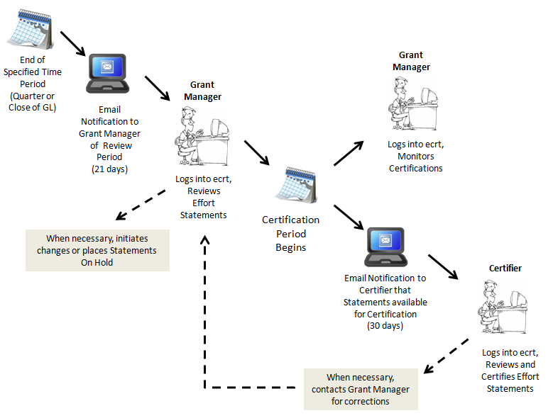
Typical Review/Certification Lifecycle
Notes:
Here’s the basic workflow for Certifiers.

Slide 24
Important Reminder-Payroll Data Confidentiality
In accordance with the University’s High Risk Confidential Information policy, it is important to remember that when viewing certification data, payroll percentages as well as dollar amounts may be viewed within the ecrt system.
Grant Managers, Primary and Secondary Effort Coordinators, Tub Effort Coordinators and Central staff are reminded that this data is confidential, and that each staff member annually signs a confidentiality statement for the University. It is expected that these guidelines will be strictly adhered to by anyone granted access to and viewing/working with Annual and Quarterly Effort Certification Statements and reports.
For more information concerning the University’s security policy, please see: http://www.security.harvard.edu/enterprise-security-policy.
Notes:
A reminder that when we are looking at certification statements, we are looking at payroll information. This information is considered confidential, and each of you signed a confidentiality agreement, which is re-authorized each year, to protect this information. It is important to understand that the information you will be viewing in the system is strictly confidential, and subject to the provisions of the overall University security policy.

Slide 25
Key University Guidelines - Annual Effort Certifications
Harvard PIs/faculty and other academic appointees who have effort on federal awards certify their academic-year and/or their supplemental/summer salary on an annual basis.
The annual effort report(s) covers the fiscal year (July 1st to June 30th) and is released for review and electronic signature in ecrt after the fiscal year end close process is complete.
Junior and senior faculty members are required to sign their own certifications, with limited exceptions.
Other academic appointees, e.g. research associates, fellows and lecturers can either self-certify or be certified by the PI or mentor of the award associated with their effort through a proxy request and authorization process.
Annual certifiers are required to review their effort statement(s) and determine whether the percentages reasonably reflect the effort expended and the work performed on the accounts listed.
Notes:
The unified University guidelines spell out the expectations for certifications of both Annual Effort statements as well as Quarterly Project Effort Certifications. This slide and the next discusses what Certifiers need to be aware of when viewing their Annual Effort Certification, and what you as a Grant Manager should be cognizant of when reviewing the statements during the Review Period.

Slide 26
Key University Guidelines Quarterly Project Effort Certifications
Quarterly Project Effort Certifications are generated for each federal award that has non-faculty salary charges at the account level
Each statement includes all non-faculty personnel who were charged to the subactivity during the quarter, including temporary.
The PI of an award or part-of account is expected to sign his/her quarterly project effort certifications.
The certifier is attesting that they have “sufficient technical knowledge and/or are in a situation that provides for suitable means of verification that the work was performed”.
There are circumstances when it may be appropriate to delegate this responsibility to another individual working on the project.
Notes:
Here is the information on Quarterly Project Effort Certifications, including the definition each quarterly period.

Slide 27
Key University Guidelines Regarding Proxies for Annual Effort Certification
A Proxy is an Authorized delegation of certification responsibilities for a certifier’s individual effort statement (Annual Faculty Effort Certifications)
Harvard academic faculty are required to sign their own annual statements.
Requests for proxies will only be granted in extenuating circumstances.
One allowable exception is when there is a mentor assigned-either the mentor or the mentee can sign the annual statement.
Proxy requests must by approved by the OSP Director of Cost Analysis or other designated individual in OSP.
A Grant Manager making such a request is expected to discuss with his/her Primary Effort Coordinator, and the PEC should make the request through their Tub Effort Coordinator, who will then submit the request to OSP for review and approval.
Notes:
While we are on the subject of who is responsible for signing off of certifications, the University-wide Effort Guidelines explicitly call out the fact that certifiers need to certify their own effort statements with the allowable exception here on the screen.
Only in extenuating circumstances can a proxy be designated. The request must be approved by the Central Office for Sponsored Programs. The request is reviewed and submitted by your school’s Tub Effort Coordinator.

Slide 28
Key University Guidelines Regarding Designees for Quarterly Project Effort Certification
Designee -Authorized delegation of certification responsibilities on a specific sponsored project to another individual (other than the PI)
Harvard University requires that the PI certify Quarterly Project Effort Certifications.
In certain circumstances, the PI can delegate this responsibility to another individual with direct knowledge of his/her federally sponsored project.
The individual who signs effort certifications must attest that the salaries charged and effort expended reasonably reflect work performed on the project, and that the signer has sufficient technical knowledge and/or is in a position that provides for suitable means of verification that the work was performed.
Requests for delegation are made on a form that will be provided to departments, Request for delegation of Authority for Quarterly Project Effort Certification. The completed and signed forms are sent to the Tub Effort Coordinator for approval.
Notes:
For designees, this is the process, and the final approval is in the hands of the Tub Effort Coordinator.’
– Designee forms should be filled out as the assignment should be entered in the system (i.e., the assignment should end on or after the end date of the certification period to allow the designee to certify). Designee forms should be renewed annually and uploaded to at least one quarterly statement within each year.
Proxy forms should be filled out per year (academic and supplemental) and uploaded to the appropriate statement.
Q: You have the system set up to send certification requests directly to 6030 Research Associates, which is not accurate.
A: it is accurate for the annual certs to be sent to 6030s, but if you wish to have exceptions to this process, you can fill out the form and send it to your TEC who will review and send it to OSP for final approval.

Slide 29
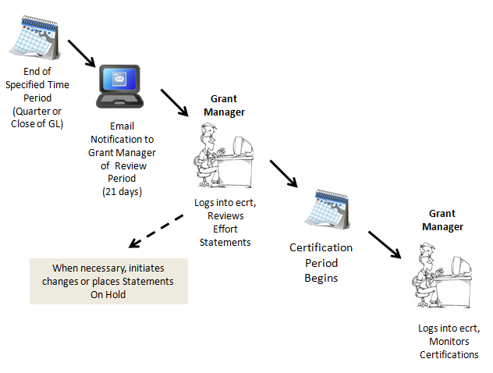
Grant Manager Workflow

Slide 30
Hands-on Grant Manager

Slide 31
Accessing ecrt
Recommended Browser with ecrt is Firefox
Obtain access through your school’s Authorized Requestor
OSP will provide the ecrt URL prior to go-live
Click the URL to navigate to ecrt, and log in with your HUID and PIN
Best recommended practice is to bookmark the URL for easy access in the future.
ecrt contains sensitive data, individuals working in ecrt should follow the guidelines stated in Confidentially Agreement signed in PeopleSoft
Notes:
Reminder about Confidentially Agreement.

Slide 32
Reviewing Certification Statements: Individual Effort Statements
A specific Effort Statement can be viewed by clicking on the Due Date, Type or Status for a particular statement of an individual.
All Effort Statements for an individual can be viewed by clicking on the Statement Owner Name.
To view your assigned Certifiers’ outstanding Effort Statements, click on My Certifier Portfolio tab.
Notes:
Patty -Is it also possible to show a screen that includes a field with a star in it, so we can indicate that when there is a star, there is more information? Add to certifier’s effort statement and add to showing on hold!
To review effort statements for your assigned certifiers, click on My Certifier Portfolio tab.

Slide 33
Reviewing Certification Statements: Individual Effort Statements
To Run a Payroll
Report for a specific account, click .
Add Notes or Attachments by clicking on or (pdf, gif, jpeg, tiff)
Best Recommended Practice is to add Attachments after the Effort Statement has been certified
Notes:
To review annual effort statements for your assigned certifiers, click on the My Certifier Portfolio tab on your Home Page and click on a certifier’s name.
Attachments: Examples of types of attachments: --Certifications manually signed prior to the certification period: If a Certifier has left the University and needed to sign-off on their effort statement before the official certification period opens, the Grant Manager or PEC can print the certification by clicking the PDF icon. The Grant Manager or PEC would then email a copy of the signed certification to the Tub EC, who would mark the statement as manually certified and upload the PDF statement as an attachment. --Re-certifications: If a statement needs to be re-certified, documentation may be attached that provides the reason for the re-certification.

Slide 34
Reviewing Certification Statements: Project Statements
Outstanding Project Effort Statements for an individual can be viewed by clicking on the Principle Investigator’s Name.
A specific Project Effort Statement can be viewed by clicking on the Period or Status.
To view your assigned Certifiers’ outstanding Project Effort Statements, click on My Account Portfolio tab.
Notes:
To review project statements for your assigned certifiers, click on My Account Portfolio tab.

Slide 35
Reviewing Certification Statements: Project Effort Statements
To Run a Payroll
Report for a specific staff member, click
Add Notes or Attachments by clicking on or (pdf, gif, jpeg, tiff)
Best Recommended Practice is to add Attachments after the Effort Statement has been certified
Notes:
To review annual effort statements for your assigned certifiers, click on the My Certifier Portfolio tab on your Home Page and click on a certifier’s name.
Attachments: Examples of types of attachments: --Certifications manually signed prior to the certification period: If a Certifier has left the University and needed to sign-off on their effort statement before the official certification period opens, the Grant Manager or PEC can print the certification by clicking the PDF icon. The Grant Manager or PEC would then email a copy of the signed certification to the Tub EC, who would mark the statement as manually certified and upload the PDF statement as an attachment. --Re-certifications: If a statement needs to be re-certified, documentation may be attached that provides the reason for the re-certification.

Slide 36
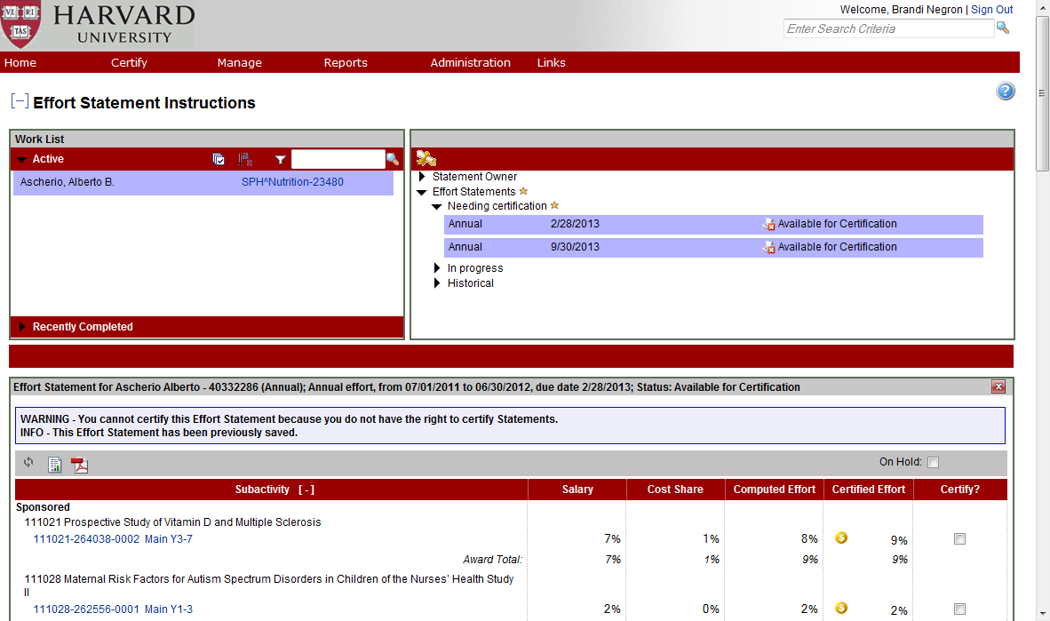
Placing Statement On Hold
icon indicates
that there is content within the folder.
When viewing a Statement, place a Statement On Hold by checking the box of On Hold and entering required comment.
Remove a hold by removing the check from the On Hold box
(re-opening for Certification)
Notes:
When viewing place statement on hold. ? Placing Multiple statements on hold (?) Comment is required.

Slide 37
Pros/Cons on Placing Statements On Hold
Pros
Prevents the statement from being certified until corrected (does not extend Certification Period)
GMs can place a statement on hold
Placing and removing hold statements are simple
Cons
No email reminder is sent to GM that statements are on hold
GMs (and/or PECs) view statements on hold through the Department Dashboard under the Certification Summary Chart
Once a statement is removed from hold, the certifier receives an automatic email that the statement has been taken off hold if the hold was placed during the Certification period
Best recommended practice: GMs should review statements as soon as possible during the grace period to avoid having to put statements on hold

Slide 38
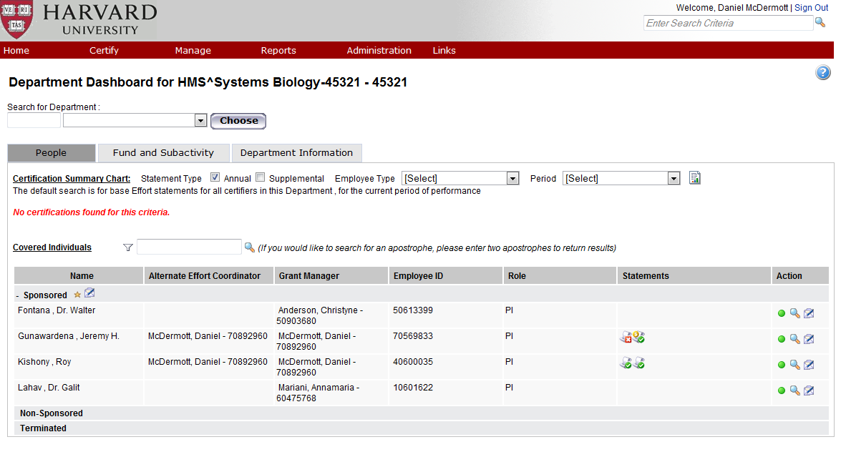
Summary of Department Certifications
Select Department Dashboard from Manage Menu.
Select Department using the drop down menu provided.
Click Choose and select the People Tab
Hover over icon to see Status and access link to Effort Statement.
When viewing a Statement, place a Statement On Hold by checking the box of On Hold.
List of Certifiers and status of Effort Statements displays.
View a Statement by clicking on the Statement Icon under Statements
Notes:
If you do not see a list of Covered Individuals after selecting the People Tab, click the (+) to expand the list.
To obtain a Summary of most recent Certifications by department use the Department Dashboard and to view any statement listed. Hover over for and check to make sure correct statement and if multiple statements – select the desired link in the pop-up.

Slide 39
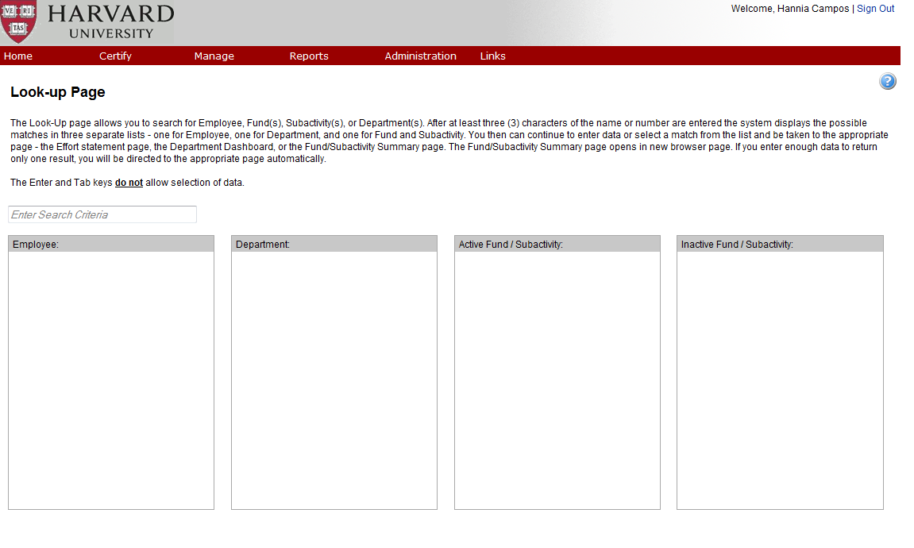
Using Lookup
Accessed through Manage Menu.
Search and Retrieve Information associated with an individual or project (fund, activity and subactivity).
Search Results listed under appropriate columns.
Best Recommended Practice is to use the Department Dashboard to retrieve individual information
Notes:
Using Lookup to
The result boxes navigate users to different screens within the system.
The Employee results box navigates users to the Annual Effort Statement for an individual.
The Department results box navigates users to the Department Dashboard for a department.
The Active/Inactive Fund/Account results boxes navigate users to the Fund/Account Summary screen for a fund or account. All project statements can be access through the Account Summary screen.
Inactive indicates that the account is past the end date, it does not refer to inactive in GMAS.
Reasons to use lookup: -A GM or PEC can use lookup to review the status of an annual effort cerfication. They can enter the HUID of the Certifier and then select the subactivity, then view the Historical Category to see if the statement is certified, however, it is recommended that the department dashboard be used to access annual effort statements. -A GM or PEC can use the lookup to review the status of a Quarterly Project Effort Certification. They can enter the first six digits of the Fund (part of the "subactivity") in the lookup field, then select the full account number, then look at the Associated Project Statements to verify the statement has status of "Certified."

Slide 40
Re-opening Certification Process
University guideline: If a payroll salary journal is posted to a federal award after the certification has been signed, and the journal creates a variance above the 3% (Quarterly, non-faculty) or 5% (Annual, faculty) threshold, the certification will be re-opened and must be re-certified by the certifier or designee.
Re-certifications should be completed within 21 days after the email is sent indicating that the certification is re-opened.
Grant Managers should add an attachment and/or note to a re-certified statement to document why the certification was re-opened.
Recommended Best Practice is to certify within the main certification period

Slide 41
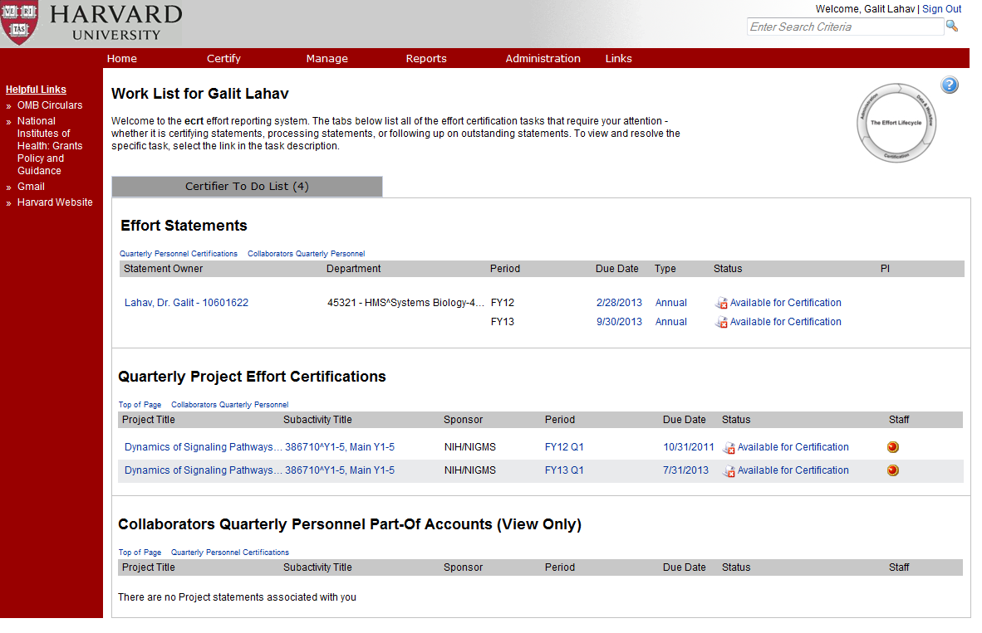
Accessing ecrt Reports
ecrt reports are divided into two categories:
Payroll/Cost Share (only group available to faculty/PIs).
Management which are available to PEC, SEC, GM and TEC.
Data available within the reports is based on the user role defined within the system.
The primary reports in use from each category are:
Payroll Report, Cost Share Report, Certifier Payroll Summary.
Certification Status Report, Certification Status Summary Report, Project Status Report and Project Status Summary Report.
Click Report Menu to access Reports.
Notes:
Reports accessed by clicking on Report Menu or clicking on the Report icon on Effort Statements window or Project Quarterly statements.

Slide 42
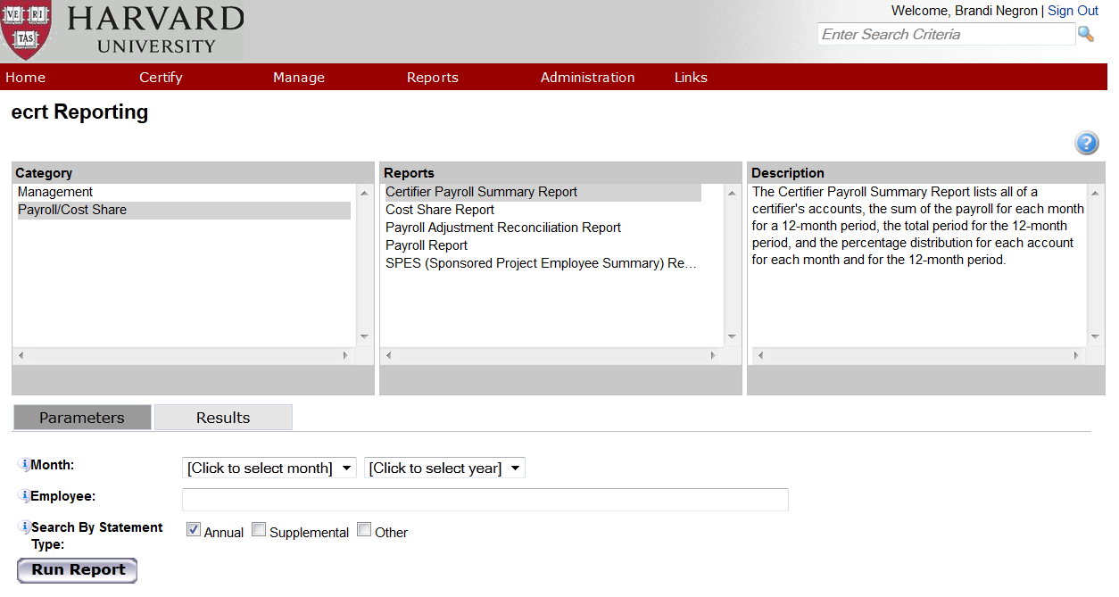
Using ecrt Reports
Select Report from Navigation bar.
Enter Parameters.
Click Run Report.
When adding a department parameter use your tub abbreviation to locate the appropriate value from the list available

Slide 43
ecrt Payroll/Cost Share Reports
Report | Contents | When to Run
Payroll Report | Lists all transactions for self and any associated Staff (based on Report Parameters) | During period of performance/review period. Review charges/allocations for accuracy.
Certifier Payroll Summary Report | Lists all transactions for self and any associated Staff (based on Report Parameters) | During period of performance/review period. Review charges/allocations for accuracy.
Cost Share Report | Lists all cost share transactions for self and any associated Staff (based on Report Parameters) | During period of performance/review period. Review charges/allocations for accuracy.
SPES (Sponsored Project Employee) Report | List of all annual/faculty and quarterly/staff transactions on account (% and $) | During period of performance/review period. Review charges/allocations for accuracy.
Notes:
Reports accessed by clicking on Report Menu or clicking on the Report icon on Effort Statements window or Project Quarterly statements.

Slide 44
ecrt Management Reports
Report | Contents | When to Run
Certification Status Report | List of all annual/effort statements for PIs to whom GM is assigned visibility | During the certification period. Monitor the status of certifications.
Certification Status Summary Report | Summary of annual/effort statement statistics for PIs with a primary department assignment in each department | During the certification period. Used to monitor the status of certifications.
Project Status Report | List of all quarterly/project statements for subactivities in department | During the certification period. Monitor the status of certifications.
Project Certification Status Summary Report | Summary of quarterly/project statement statistics for PIs with a primary department assignment in tub | During the certification period. Monitor the status of certifications.
Notes:
Reports accessed by clicking on Report Menu or clicking on the Report icon on Effort Statements window or Project Quarterly statements.

Slide 45
ecrt Reports for Grant Managers
Report | Contents | When to Run
Payroll Adjustment Reconciliation Report | The Payroll Adjustment Reconciliation Report provides a list of certifiers with Effort statements that have been reopened via the Payroll Adjustment Reconciliation process. The results also display which Department(s) have payroll transactions currently suspended. | Throughout the process to track results of journal entries.
Department Account | Lists all funds/subactivities in department with link to fund/subactivity summary screen. | On demand to view department subactivity details.
Notes:
Reports accessed by clicking on Report Menu or clicking on the Report icon on Effort Statements window or Project Quarterly statements.

Slide 46
Best Practices for Grant Manager
Review Certification Statements in timely manner during the Review Period, so that corrections can be made before Certification period.
Any hold should be done in the Review Period rather than the Certification Period.
Hold comment should reflect why the Effort Statement was put On Hold.
Attachments should be added to the Effort Statement after it has been certified.
Notes:
Best practices for attachments and notes.

Slide 47
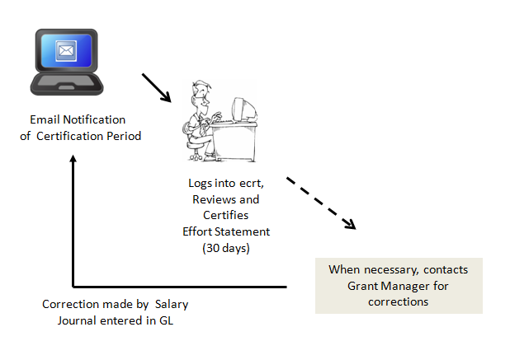
Workflow for Certifier (Certification Period)
Notes:
Here’s the basic workflow for Certifiers.

Slide 48
Hands-on Certifier

Slide 49
ecrt Home Page
To exit ecrt, use Sign Out.
To system help references, click .
Your Personal Work List always displays on ecrt Home Page
Notes:
Home page of ecrt displays and always displays your personal work list. To exit, select Sign out. To view system help references, click on the question mark icon that appears on any window.
To locate Harvard specific help information, refer to the link “Harvard ecrt Wiki” on the left side of the Home Page.

Slide 50
ecrt: Home Page Personal Work List
Effort Reporting Information and Tasks organized by Tabs.
Certifiers only have one tab, Certifier To Do List. Others display Effort Tasks tab by default, when there are effort tasks requiring their attention.
Notes:
Your work list organizes effort reporting information and tasks by Tabs and the tabs that display depends upon your role. A certifier will only see the Certifier To Do List which contains effort tasks requiring their attention - a list of effort and project statements that they are required to review and certify. A Grant Manager, PEC, SEC, and TEC work list always displays the Certifier To Do List, but these individuals should instead look to the My Certifier Portfolio and My Account Portfolio Tabs to review and monitor the outstanding certification statements in their portfolio. Additionally, an effort tasks tab will display and will be the default tab when the GM, PEC, SEC and TEC access ecrt and there are effort tasks requiring their attention.
Note – may only want to talk about certifier at this point!

Slide 51
ecrt: Navigating the Home Page
Navigation bar contains Menus grouping commands.
Most information displayed on Tabs can be sorted by clicking on the title of the column.
Clicking on the Home Menu always returns to displaying your Personal Work List
Notes:
Navigation bar contains menus grouping commands. Most of the commands you access can be accessed directly from clicking on information contained in the tabs or by selecting commands from the menus. Information displayed on a tab can be sorted by clicking on the title of the column. Clicking on Home always displays your personal work list.

Slide 52
ecrt: Personal Work List – Certifiers
Individual Effort Statements requiring certification.
Project Effort Statements requiring certification.
Collaborators Qtrly Personnel Part-off Accounts – View Only.

Slide 53
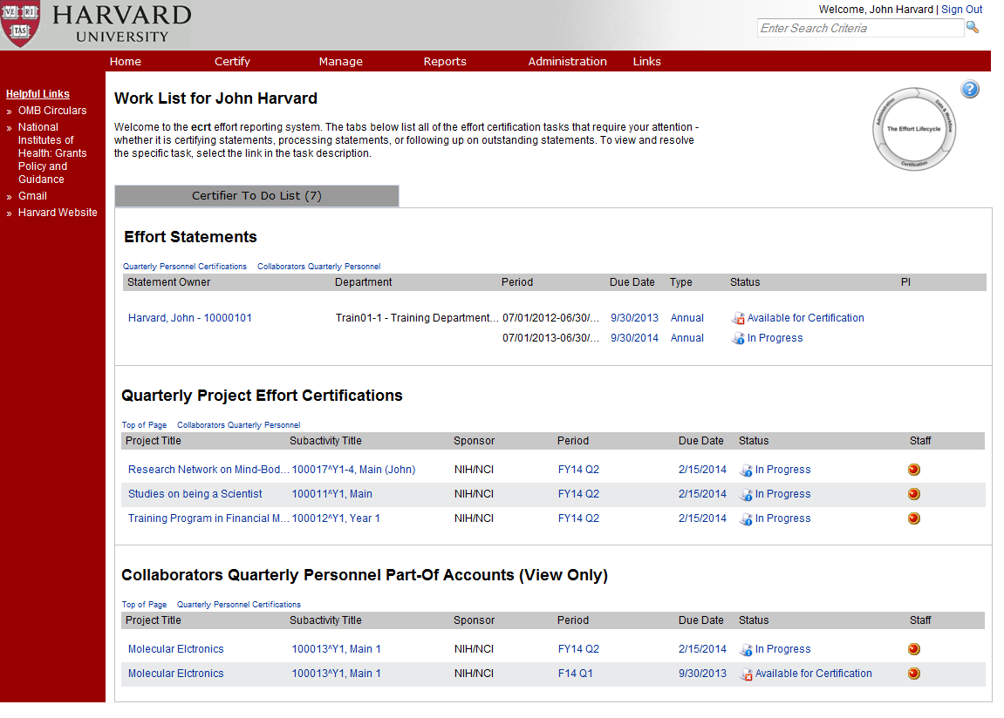
Accessing Certification Statements: Individual Effort Statements
A certifier can view their annual effort by clicking on their name under Statement Owner Name.
A specific Effort Statement can be viewed by clicking on the Due Date, Type or Status for a particular statement.

Slide 54
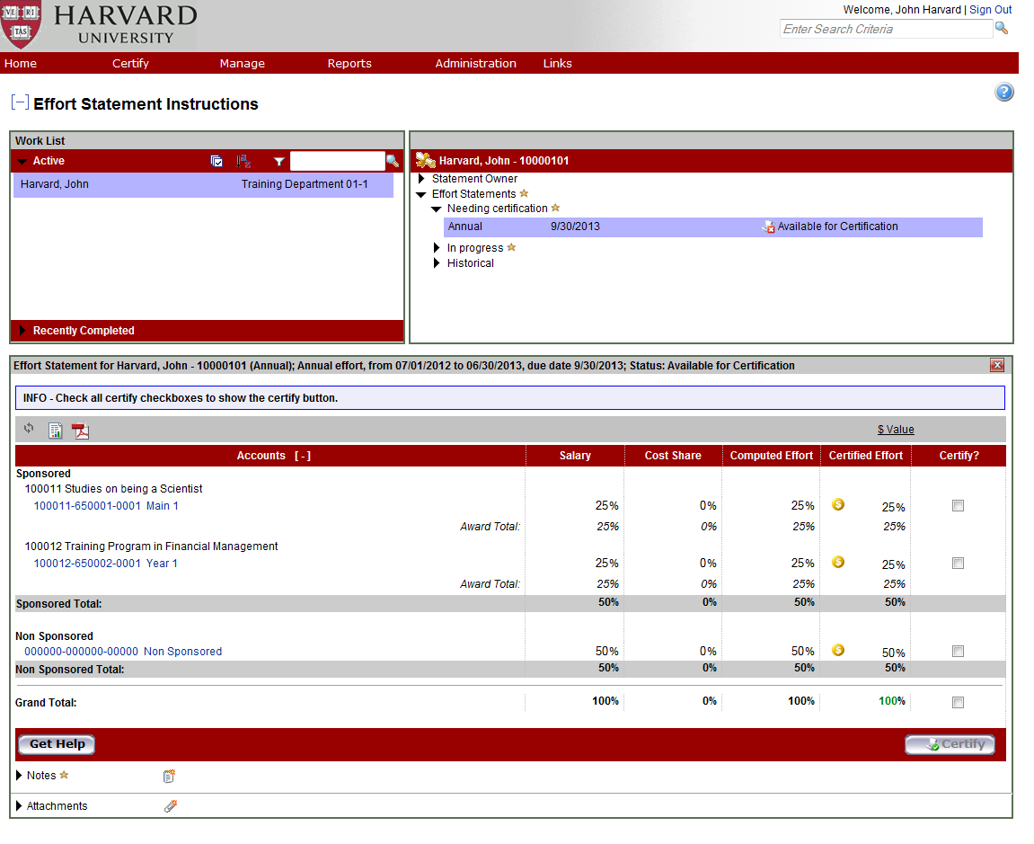
Effort Statement: Navigating
icon indicates
that there is content within the folder.
To view dollar amounts, click on $ Value (to return to % values, click % Value).
opens email to send message that corrections are necessary to PEC.
To Run a Payroll
Report for a specific account click .
Best Recommended Practice: cc: your Grant Manager when using Get Help to send message that corrections are necessary.
Notes:
Effort statement or statements are reviewed in the effort statements window that appears. Go thru additional features (not outline here)

Slide 55
Certify Effort Statement
Review each line and if correct check the Certify checkbox. You can only certify by % not $
Click Certify checkbox of Grand Total to check off all.
Click Certify when all are reviewed (correct) and checked.
Best Recommended Practice: Do NOT certify any Statement that needs corrections.
Notes:
Effort statement or statements are reviewed in the effort statements window that appears. Go thru additional features (not outline here)
The statement must be in % mode to certify.
Q: Why can't I click on the certify button? (For non-certifiers)
A: because only certifiers can click the certify button.
When the Certify button is clicked, an attestation statement appears. Click OK on the attestation pop-up window

Slide 56
Accessing Quarterly Project Effort Statements
A certifier can view their quarterly project effort statements by clicking on a Project Title.
To review and certify a Specific Project Statement for an account, click on the Period, Due Date or Status of Statement.

Slide 57
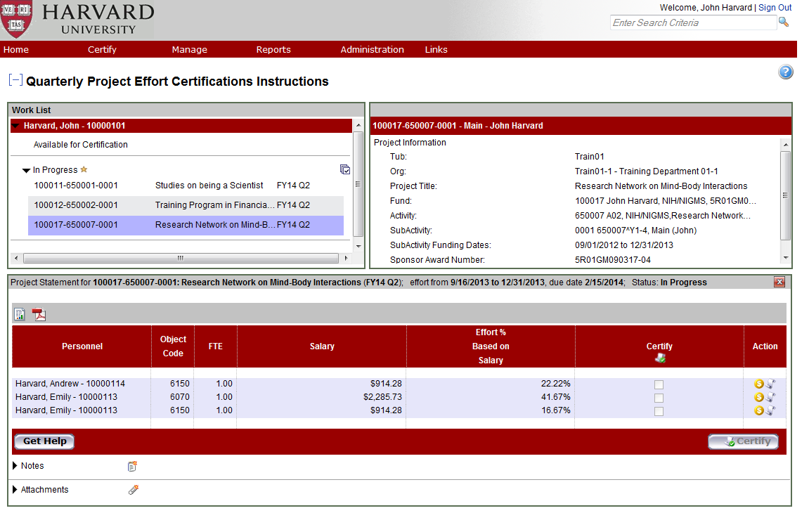
Certify Quarterly Project Effort Statement
Click to select all lines on the statement. Click Certify when all are reviewed (correct).
Click to view Project Payroll Summary details for an individual
Review each line and if correct check the Certify checkbox.
Do NOT certify when corrections are necessary. Once certified the statement is removed from your home page.
Notes:
Go thru additional window features not listed here.

Slide 58
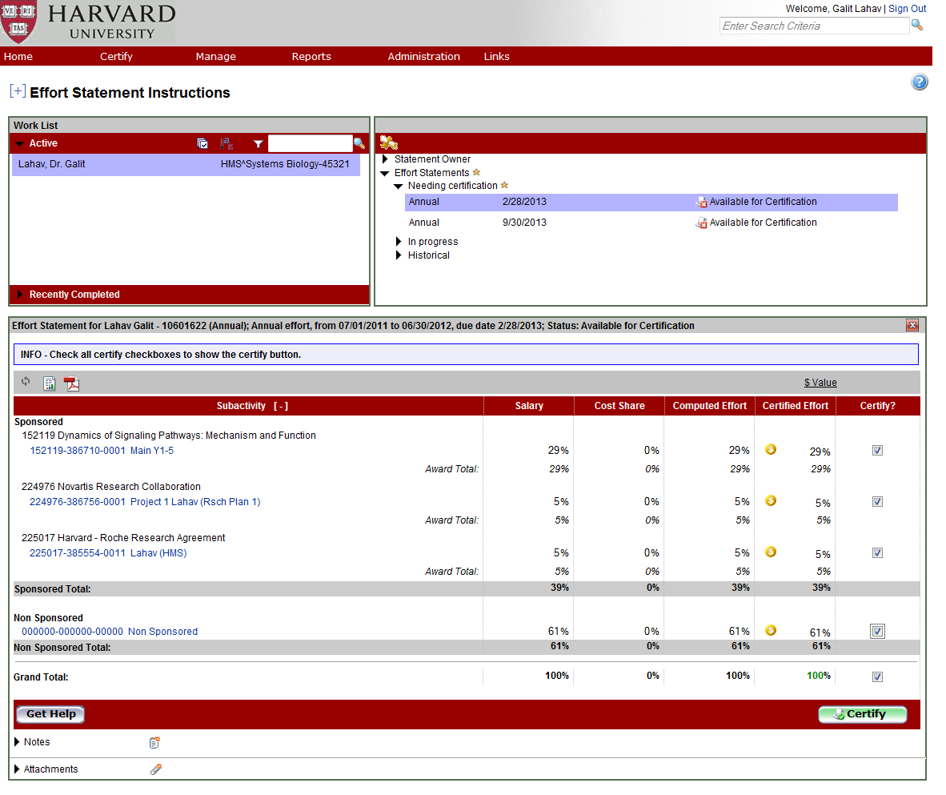
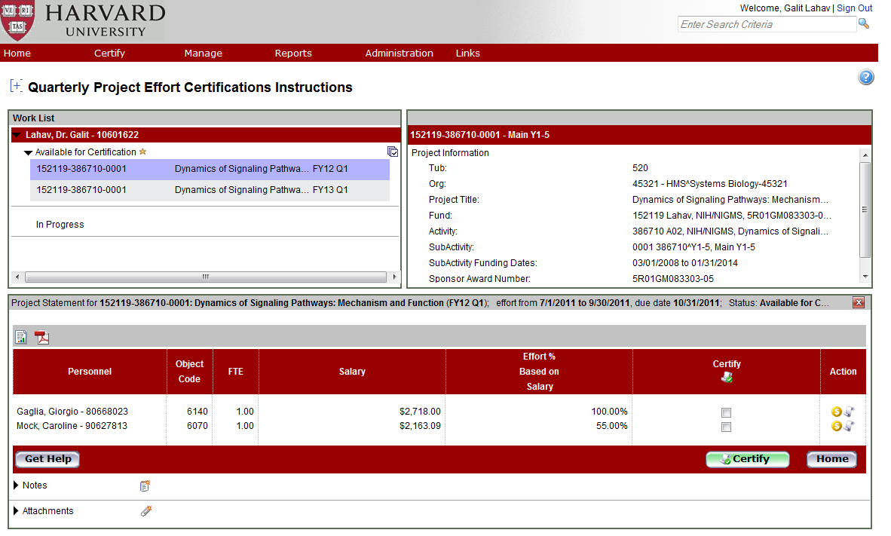
ecrt Reports Accessible from Certification Statements
Effort Statement reports available:
Payroll Report, Cost Share Report and Certified Payroll Summary Report are available.
Quarterly Project Effort Certification reports available:
SPES Report, Certifier Payroll Summary Report, link to the Annual Effort Statement (when logged in as a certifier) and a link to the Account/Award Summary screen are available.
Parameters are automatically defined for the report.
Data displayed is specific to the statement selected.
From Effort Statement or Quarterly Project Effort Certifications click on to access payroll/cost share reports.
Notes:
Reports accessed by clicking on Report Menu or clicking on the Report icon on Effort Statements window or Project Quarterly statements.
Note that you may have to disable your pop-up blocker.

Slide 59
Best Practices for Certifiers
Review and Certify Effort Statements in a timely manner during the Certification Period, so that corrections can be made before the end of Certification period.
When corrections are necessary, do NOT Certify the Statement, contact the Grant Manager to initiate corrections.
When using the Get Help Button on the Effort Statement window to initiate corrections the Primary Effort Coordinator (PEC) will be notified, be sure to cc: your Grant Manager.
Notes:
Best practices for attachments and notes

Slide 60
Icons representing Effort Statement Status
ICON | STATUS DESCRIPTION
 | In Progress**
 | Certified Manually, Pending OSP Review
 | Certified Manually**
 | Certified Manually, Pending Review of Salary Adjustment
 | No Certification Required, Pending OSP Review
 | No Certification Required**
 | No Certification Required, Pending Review of Salary Adjustment
 | Available for Certification**
All statuses apply to Annual Effort Statements, only those with an ** by the description apply to Qtly Project Effort Statements
Notes:
On the Department Dashboards, at a glance you can see the status of effort statements by the icons represent the status of Effort Statements. Here is a list that you will encounter.

Slide 61
Icons representing Effort Statement Status (Cont.)
ICON | STATUS DESCRIPTION
 | Multiple Statements, Different Statuses
 | Certified, Pending Grant Manager Review
 | Certified**
 | No Certification Required, Non-Reportable**
 | Certified, Pending Review of Salary Adjustment**
 | Available for Certification, Re-Opened**
 | Available for Certification, Re-Opened by Salary Adjustment**
All statuses apply to Annual Effort Statements, only those with an ** by the description apply to Qtly Project Effort Statements
Notes:
On the Department Dashboards, at a glance you can see the status of effort statements by the icons represent the status of Effort Statements. Here is a list that you will encounter.

Slide 62
Questions about Certifiers Role?
Notes:
Excuse certifiers

Slide 63
Troubleshooting and Escalation

Slide 64
Troubleshooting
Question/Problem | Who to Contact
Grant Manager Questions | Primary Effort Coordinator
Tub-specific policy Questions | Tub Effort Coordinator
Proxy Requests | Tub Effort Coordinator, who will then turn in form to Office for Sponsored Programs for Approval [ecrt@harvard.edu]
Designee Requests | Primary Effort Coordinator, who will then turn in form to Tub Effort Coordinator for Approval
Technical Problems (logging in, error messages, etc.) | Office for Sponsored Programs/Financial Systems Solutions, via the ecrt mailbox: ecrt@harvard.edu
University Policy Questions | Office for Sponsored Programs/HMS Sponsored Programs Administration/SPH Research Administration/FAS Research Administration
Access Requests | School’s Authorized Requestor
Notes:
there is an informal process locally—meaning that the PEC/TEC will have to know that you need access to the system, so that you are assigned to the appropriate PEC. I have not seen the security form for ecrt, but I would think that there would have to be an internal process that would allow the Authorized Requestor the ability to make the request to Client Services so that a new GM could be set up correctly.

Slide 65
Questions?

Slide 66
Primary Effort Coordinator Workflows

Slide 67
Primary Effort Coordinator Workflows
In this unit, we will
Review the role of the Primary and Secondary Effort Coordinators.
Review the reports PECs should run during the certification process to keep track of outstanding and approved certification statements during the certification period.
Restrict the role of a Grant Manager.
Perform a Grant Manager override for part-of statements.
Get additional help with troubleshooting and escalation.

Slide 68
Primary (Secondary) Effort Coordinator (PEC/SEC)
In addition to the responsibilities spelled out earlier, the PEC/SEC has the ability to perform the following functions:
Run reports demonstrated earlier at the Departmental level
Perform a Grant Manager override for “part-of” grants
Assign Grant Managers to a Restricted/Unrestricted status
Role determines which ecrt functions and information you can access, this is tied to your Harvard ID and PIN login.
Notes:
Within a Tub, each department has a defined primary effort coordinator. These individuals are responsible for facilitating the effort reporting process in their department, they determine and assign roles for their department effort reporting, and are the main contact for all department effort reporting.
One or More secondary effort coordinators may be identified for the department and perform the same functions as the primary effort coordinator.

Slide 69
Hands-on Primary Effort Coordinator
Notes:
Now let’s take a look at re-budgeting in any award year.

Slide 70
Grant Manager Roles for Existing Users
For existing users, Grant Manager responsibilities have been set at Harvard with the following defaults:
FAS: Every grant manager has been set up as a restrictive grant manager
All other schools (unless specifically noted): Every grant manager has been set up as unrestricted
A restricted Grant Manager can only view the certifiers to which he or she has been assigned.
An unrestricted Grant Manager can view, all of the Grant Managers and their assigned PIs in their Department.
Restricted Grant Manager Department View | Unrestricted Grant Manager Department View
Restricted GM
PI/Faculty Member 1
PI /Faculty Member 2
Unrestricted GM 1
PI/Faculty Member 1
PI /Faculty Member 2
Unrestricted GM 2
PI/Faculty Member 1
PI /Faculty Member 2
Unrestricted GM 3
PI/Faculty Member 1
PI /Faculty Member 2
Notes:
Here is how Grant Manager assignments have been made in the system for existing users.
All certifiers on a department’s list should have a Grant Manager assignment. If not, the PEC or SEC is repsonsible for assigning a GM. If the certifier does not have a GM, assign the certifier to the Primary Effort Coordinator.
If a Grant Manager is restricted, their name appears in the Alternate Effort Coordinator column next to the certifiers to whom they are assigned visibility. If a Grant Manager is Restricted, they must be restricted to all certifiers in their portfolio.

Slide 71
Assigning Grant Manager Roles for New Users
For new users:
New users will be granted access to ecrt via their Authorized Requestor
PECs will then need to assign GMs to their portfolio of certifiers and assign either restrict or unrestrict view access to the rest of the Department
FAS GMs should be set as restricted
All other schools as unrestricted; PECs have the option to restrict view to rest of department
Restricted Grant Manager Department View | Unrestricted Grant Manager Department View
Restricted GM
PI/Faculty Member 1
PI /Faculty Member 2
Unrestricted GM 1
PI/Faculty Member 1
PI /Faculty Member 2
Unrestricted GM 2
PI/Faculty Member 1
PI /Faculty Member 2
Unrestricted GM 3
PI/Faculty Member 1
PI /Faculty Member 2
Notes:
A PEC may opt to do this because they have a new or junior Grant Manager and the PEC does not want this GM to see everything right away.
If a Grant Manager is restricted,

Slide 72
Setting Grant Manager Responsibilities
Select Manage, Department Dashboard.
On the Department Information Tab, PEC will be highlighted in yellow.
To assign GM responsibilities, click on Notepad icon next to GM’s name
Notes:
Reports accessed by clicking on Report Menu or clicking on the Report icon on Effort Statements window or Project Quarterly statements.

Slide 73
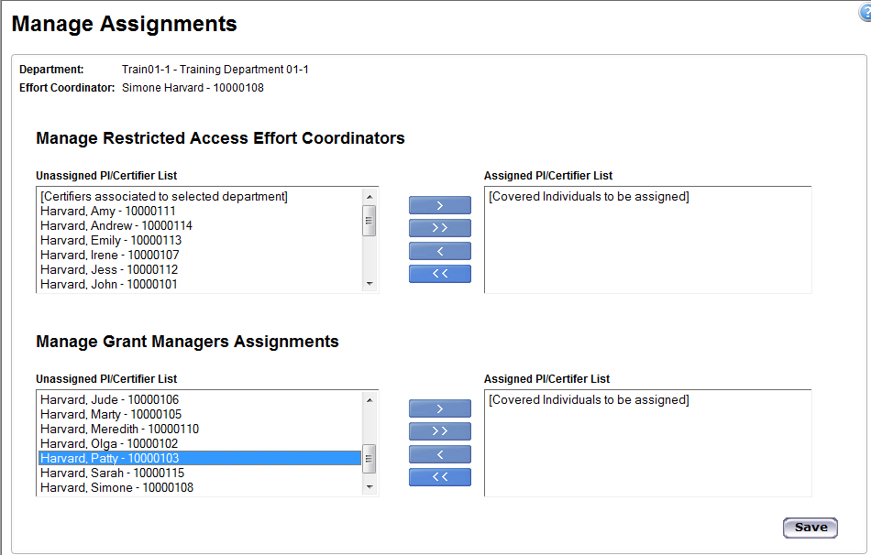
Manage Assignments Pop Up Screen
Select right arrow button to move Faculty/PI
Select Manage, Department Dashboard.
PI/Certifier name will appear here
Select PI/Certifier from list
Notes:
Reports accessed by clicking on Report Menu or clicking on the Report icon on Effort Statements window or Project Quarterly statements.
If a certifiers name does not appear in the unassigned list, it is likely because they already assigned to another Grant Manager. You must first unassign them from one GM in order to assign them to a different GM.

Slide 74
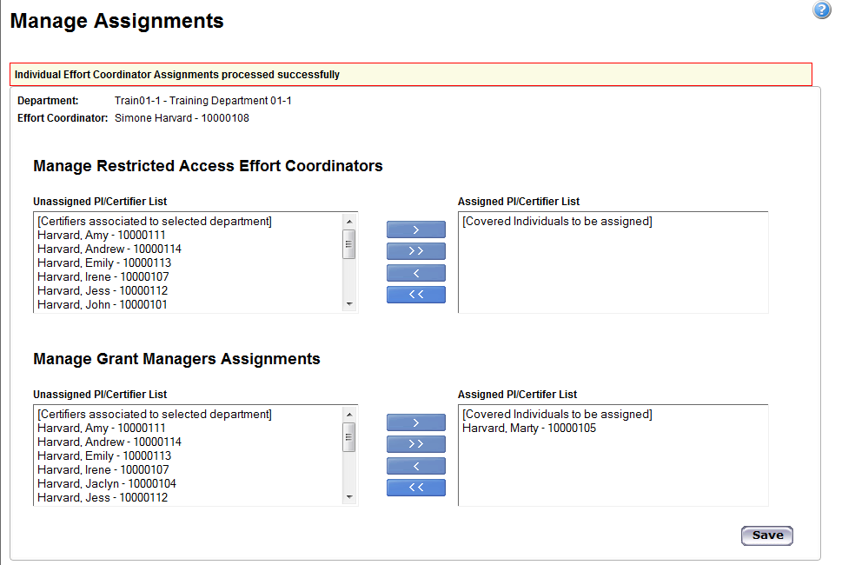
Manage Assignments Pop Up Screen
Faculty/PI appears under Assigned PI/Certifier List
Click Save
Notes:
Click save.

Slide 75
Managing Assignments-Clicking Save Restricts GM
When you click Save, the PI will appear in both the top and bottom boxes.
The top box on this screen means that the GM is now Restricted to only seeing this PI
If this is correct, close the Managing Assignments Pop Up box by clicking on the X in the top right corner. The GM will be restricted.
If this is incorrect, remove the certifiers from the Restricted Box and then re-Save the record. The GM will then be unrestricted.
Notes:
If you are an FAS, you will not have access to the Manage Restricted ECs section. In other words, all GMs will be restricted.

Slide 76
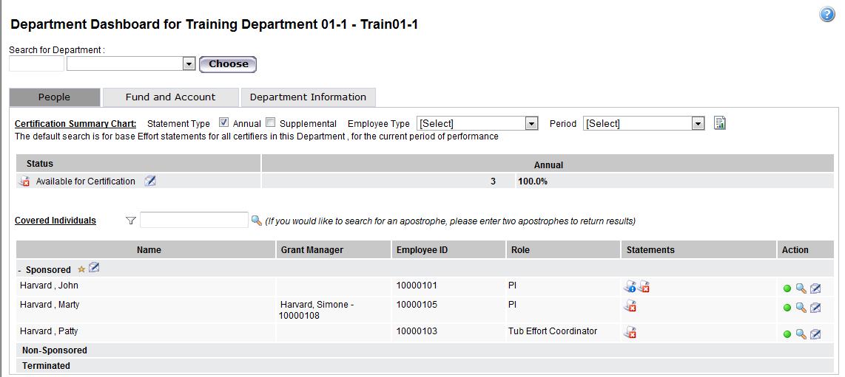
Review Assignments-Unrestricted Grant Manager
Select People Tab
In this example, Simone Harvard is an Unrestricted Grant Manager. Her name will appear under the d Grant Manager Column

Slide 77
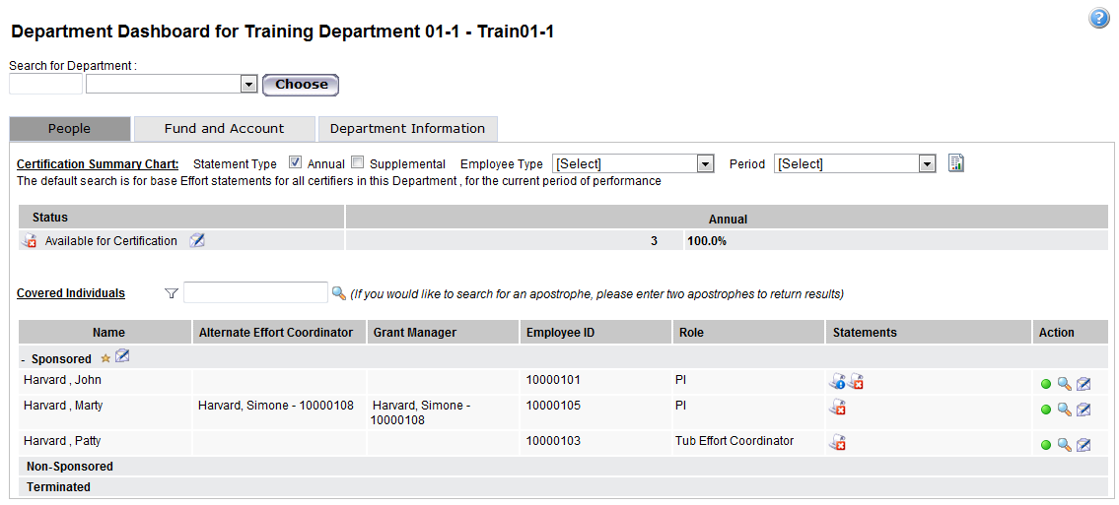
Review Assignments-Restricted Grant Manager
Select People Tab
In this example, Simone Harvard is a Restricted Grant Manager. Her name will appear under the both the Alternate Effort Coordinator and Grant Manager Columns

Slide 78
Grant Manager Overrides
NIH Grant 101
Awarded to Professor Gonzalez, Epidemiology
123456-123456-0000
Accounts owned by Epidemiology
123456-123456-0002
Accounts owned by Nutrition
123456-123456-0001
In this example, a grant has been awarded to Professor Gonzalez in Epidemiology.
An account under this award/fund is owned by Nutrition
When this grant is initially set up in ecrt, all accounts on which Professor Gonzalez is named the PI will be overseen by Professor Gonzalez’ Grant Manager in Epidemiology.
The Primary Effort Coordinator (PEC) in Nutrition, however, has the option of assigning a Nutrition Grant Manager to oversee Professor Gonzalez’ account that is awarded through Nutrition. It is assumed that the appropriate communication concerning this has occurred between the two departments.
Notes:
Here we have a grant that has been awarded to a professor in epidemiology, and a portion of the grant, is owned by another department.
When this grant is initially set up in ecrt, all subactivities will be overseen by Professor Gonzalez’ Grant Manager
The Primary Effort Coordinator (PEC) in Nutrition, however, has the option of assigning a Nutrition Grant Manager to oversee Professor Barrett’s part of the grant. It is assumed that the appropriate communication concerning this has occurred between the two departments.

Slide 79
Grant Manager Overrides (Cont.)
NIH Grant 101
Awarded to Professor Gonzalez, Epidemiology
123456-123456-0000
Accounts owned by Epidemiology
123456-123456-0002
Accounts owned by Nutrition
123456-123456-0001
The Nutrition PEC can implement a “grant manager override” to assign the Nutrition Grant Manager for Professor Gonzalez’ portion of the grant that runs through Nutrition. This is optional and depends on whether or not Nutrition wants to govern the charges on the specific account under the grant.
As the award owner, the Epidemiology PEC can still access the grant and see whether or not the project statement in Nutrition has been certified, and can contact the Nutrition PEC if Professor Gonzalez (or a part-of PI, if assigned) has not certified in a timely manner.
Notes:
Here we have a grant that has been awarded to a professor in epidemiology, and a portion of the grant, is owned by another department.
When this grant is initially set up in ecrt, all subactivities will be overseen by Professor Gonzalez’ Grant Manager
The Primary Effort Coordinator (PEC) in Nutrition, however, has the option of assigning a Nutrition Grant Manager to oversee Professor Barrett’s part of the grant. It is assumed that the appropriate communication concerning this has occurred between the two departments.

Slide 80
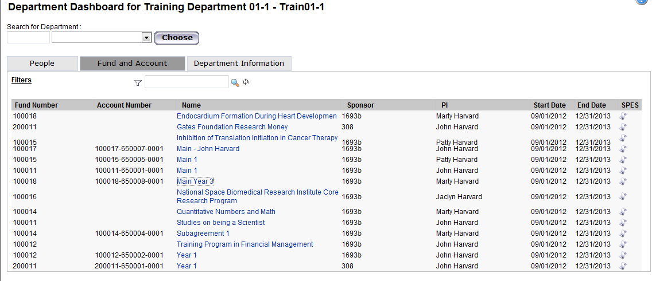
Grant Manager Override
Select Manage, Department Dashboard.
Select the Fund and Account Tab
The list of fund, activity & subactivity strings appear; click on the the Account Name link that you wish to override
Notes:
You can use the filter icon and search box to locate accounts quicker. Simply click the filter icon, select the criteria by which you want to search, and enter the criteria in the search box. Once entered, click the magnifying glass – the list will pull results related to your search.

Slide 81
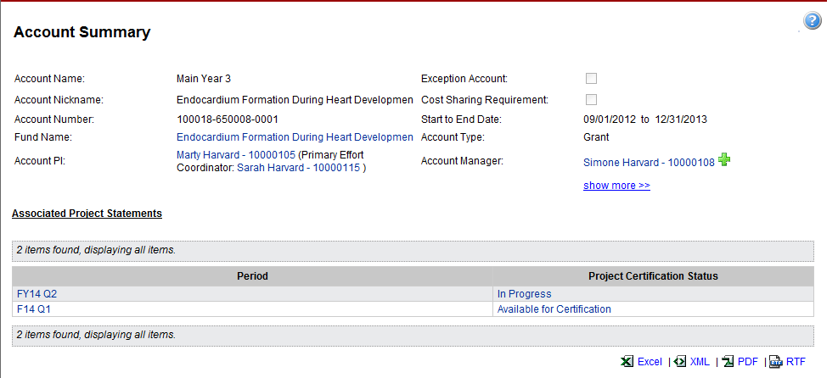
Account Summary Page
The current Account Manager appears on the screen
To change the Grant Manager, click on the green + sign

Slide 82
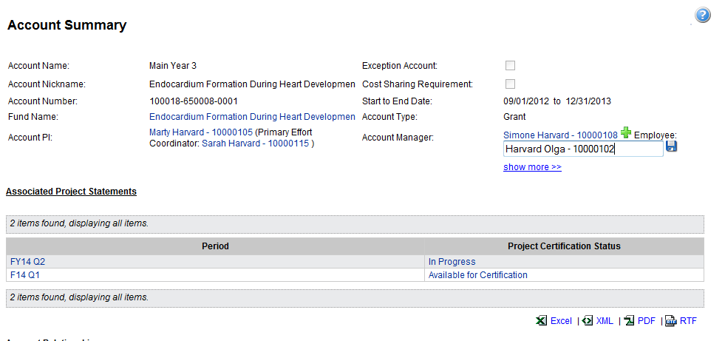
Enter Name of Grant Manager
Type in last name, first name of new Grant Manager and click floppy disk to save

Slide 83
New Grant Manager/Revert to Previous Grant Manager
The new Grant Manager now appears.
To revert back to the previous Grant Manager, click on the red minus icon

Slide 84
Questions?

Slide 85
FAQs - Certification
Why do some of my certifiers have a total effort % that is 99% or 101%?
Because we are certifying in whole numbers, the system will round up to 1% if the computed effort (salary + cost share) equates is greater than 0%, but less than 0.5%. Often this will result in total effort of 99%-101%.
Shouldn’t certifiers only certify 100% effort?
Due to rounding, the system allows certifiers to certify effort from 99%-101%. If a certifier refuses to certify anything but 100% effort, please contact the ecrt Help Desk and copy your tub effort coordinator.
Does the FTE come into play in ECRT; what if you are certifying for a half-time employee?
The effort % in ecrt is based solely on the charges to an account out of the total salary charges for an individual. Even though we display the FTE value, it does not impact the calculated effort % in ecrt.
Will certifiers be notified and reminded that they need to certify?
Every certifier in the system will receive an initial email to let them know the certification process is open and ready. In addition, 3 reminder emails will be sent to each certifier when there are 14, 7, and 3 days remaining if the certifications are still not complete.
Notes:
FAQs

Slide 86
FAQs - Review
What if my certifier has over 101% effort?
Always review the charges first to ensure that the allocations are correct. If the allocations are incorrect, a salary journal will need to be processed to correct the charges.
If the total effort is greater than 101% due to rounding or salary journals incorrectly coded to FY13, please contact the ecrt Help Desk.
Why do some transactions have a start and end date of 7/1/2012-6/30/2013 (FY13)?
With the exception of SPH, all salary journals to annual object codes that were posted in FY13 were hard coded with these dates to account for the missing period of performance field in the GL. As of FY14, all journals will list the quarter selected in the GL (or Wasabi).
Why does the payroll data not include accruals?
ECRT pulls in detailed payroll transactions and captures actual costs. The system automatically prorates the payroll based on the period of performance for what is hitting the G/L.
Will a PEC/TEC receive an email notifying them of them of the status of who hasn¹t certified?
The PEC will be sent an email that will summarize and list the individuals in that department who received a certification period opening email and the individuals who had not completed certification when each reminder email was sent. The email also lists those who were auto-processed. There are also several monitoring reports that can aid tub and department administrators in reviewing the status of all certifications in their respective unit.
What if there are spelling errors in project titles or certifiers names?
GMAS is just a repository and pulls information from multiple sources. If there are spelling errors in project titles, etc. you would need to go to the source system, such as GMAS, in order to correct.
Notes:
FAQs

Slide 87
FAQs - Department Setup/Security
Why did statements get routed to me or one of my grant managers when the certifier and his/her accounts do not belong in our portfolios?
The department configurations were setup based on the most recent documentation completed during the ecrt Department Outreach effort.
Portfolios may have since changed, and can now be updated and managed by the department Primary Effort Coordinator or any Secondary Effort Coordinators who have the same security.
If your documentation was not finalized or confirmed, the configuration was setup to the best of our knowledge and should be updated by the Primary or Secondary Effort Coordinator.
What if there are faculty or other academic appointees who belong to my department and have sponsored charges, but do not appear on my Department Dashboard?
If a faculty member or other academic appointee does not appear in your department, the individual was either not assigned to a department or may have been assigned to another department.
If you know that your department is responsible for the annual effort certification for this individual, submit a request for security through your designated Authorized Requestor.
Notes:
FAQs

Slide 88
FAQs - Department Setup/Security (Cont.)
How do I verify that my department administrators have the appropriate security?
If you are requesting a change in role for an individual who is currently assigned to your department, e.g. making a grant manager a primary effort coordinator, you should first verify their current security role. You should also verify an individual’s security role after a new administrator has been assigned to your department per a request for security access.
On the Department Information tab of the Department Dashboard, click the Manage User icon ( ) next to an effort coordinator (i.e. department administrator). On the Manage Users screen, scroll to the bottom and review the Roles section. A checkmark should appear next to the appropriate security roles for that individual.
Access to this functionality is only available to Tub Effort Coordinators, Primary Effort Coordinators, and any Secondary Effort Coordinator who have the same security.
If a role is incorrectly assigned, please contact the ecrt Help Desk.
Notes:
FAQs

Slide 89
FAQs - Other
What is the plan to train faculty and provide them with the training materials?
Currently, we do not have a formal training session geared towards the certifiers and designees. We will, however, have online simulations as well as quick reference cards that the certifiers can use to guide themselves through the process. Because we are relying more on the PEC’s and GM’s to work one-on-one with certifiers, we will train these individuals on the system screens unique to certifiers and the specific actions certifiers must take to complete the certification.
Notes:
FAQs

Slide 90
Resources
Information about OMB A-21 can be accessed here: http://www.whitehouse.gov/omb/circulars_a021_2004
Information on OSP's policy handbook http://osp.fad.harvard.edu/content/osp-policy-handbook?tid=All
Available on Eureka (pin required) - http://eureka.harvard.edu
Online simulations
Work Aid
Information about the Effort Reporting Project (pin required): https://wiki.harvard.edu/confluence/pages/viewpage.action?pageId=55642846
Notes:
Review list of resources

Slide 91
Wrap-up
Questions?
Comments?
Thank you for coming!
Notes:
Thank participants for coming.

