Slide 1
ecrt (Effort Certification and Reporting Technology)
Financial Administration

Slide 2
Topics
Overview
Effort and Compliance Requirements
Overview of ecrt and the Effort Reporting Lifecycle
Terms and Definitions
Policy Overview
Introduction to ecrt for Effort Certification
Roles and Responsibilities
Tasks and Workflow by Role
Troubleshooting and Method for Adjustments
Tips and Tricks
Questions

Slide 3
Why Certify Effort?
Effort - Effort is the proportion of time spent on any activity and expressed as a percentage of the total professional activity for which an individual is employed by the institution, regardless of the appointment (e.g., 0.5 FTE, 0.625 FTE, 1.0 FTE)
Salary is charged based on an estimate of how effort will be expended; must then verify how effort was actually expended so that the charges are appropriate
Certification is a means of verifying that appropriate labor expenses were charged to sponsored agreements and ensures proper use of sponsored funds
Effort directly charged to a sponsored project
Effort cost shared to the sponsored project (expended in support of the project but paid by Harvard)
Documents that commitments to the project or cost share have been met
Labor expenses typically represent the majority of direct costs of research (therefore, auditors focus here first)
Captures academic department cost, which is part of the administrative (F&A) cost rate

Slide 4
Uniform Guidance 2 CFR, Part 200
As recipients of federal research funding, universities must abide by US Government Office of Management and Budget Uniform Guidance 2 CFR, Part 200
Effort Reporting Requirements:
After-the-fact activity reports must reflect the distribution of activity expended by employees, as a percentage.
Report must reasonably reflect the activities for which employees are compensated by the institution.
Must confirm that the distribution of activity represents a reasonable estimate of the work performed by the employee during the period.
Reports must be signed by the employee, principal investigator, or responsible official using suitable means of verification that the work was performed.
Confirmation of personnel costs charged to sponsored agreements.
Certification of all employee activities on an integrated basis (i.e., 100% effort).

Slide 5
Risks of Non-Compliance
Impact to the Institution:
Susceptible to False Claims Act allegations.
Institute may owe direct cost refunds.
Sponsor may reduce future funding.
Adverse publicity.
Impact on the Individual:
Susceptible for False Claims Act allegations.
Possible criminal charges.
May lose access to current institutional funding.
Notes:
Here are some of the risks of non-compliance to both Harvard and to the individual

Slide 6
Think It Can’t Happen Here?
Results of Previous Government Audits
Institution | Reason | Fine Amount
Yale University | Effort Reporting/Cost Transfers | $7.6 million
Florida State University | Salary/Nonsalary disallowances | $3.0 million refund requested
St. Louis University | Overstatement of effort | $1 million
Weill Cornell Medical College | Committed Effort | $2.6 million
Harvard University | Allegations of overbilling the NIH | $2.4 million

Slide 7
Effort Reporting Red Flags
Late or missing effort reports
Effort certified by someone without suitable means of verification
Certified percentage of non-sponsored activities not credibly sufficient to cover teaching, clinical work, administrative or other University work
Recertification of effort reports
Principal Investigator with 0% or 100% effort charged to a sponsored award
Significant data inconsistency between effort reports and other documentation such as:
Teaching schedules/calendars
Other Support Forms
Outside Activity Reports
Notes:
From a central standpoint, we rather see a late certification that is correct rather then a recertification. It is imperative that the effort reports are reviewed and corrected before they are signed.

Slide 8
Effort Reporting Policy

Slide 9
Annual Effort Certification
Harvard PIs/faculty and other academic appointees who have effort on federal awards certify their salary on an annual basis.
Junior and senior faculty members are required to sign their own certifications, with limited exceptions.
Other academic appointees, e.g. research associates, fellows and lecturers can either self-certify or be certified by the mentor or PI of the award associated with their effort through a proxy request and authorization process.

Slide 10
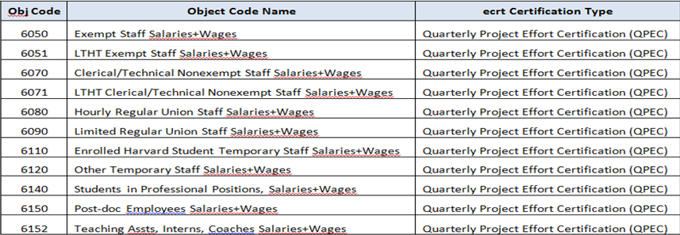
Quarterly Project Effort Certification
Quarterly Project Effort Certifications are generated for each federal award that has non-faculty salary charges at the account level
Each statement includes all non-faculty personnel who were charged to the subactivity during the quarter, including temporary.
The PI of an award or part-of account is expected to sign his/her quarterly project effort certifications.
There are circumstances when it may be appropriate to delegate this responsibility to another individual working on the project.

Slide 11
Proxies for Annual Effort Certification
Proxy - Authorized delegation of certification responsibilities for a certifier’s individual effort statement (Annual Faculty Effort Certifications)
Harvard academic faculty are required to sign their own annual statements.
Requests for proxies will only be granted in extenuating circumstances.
One allowable exception is when there is a mentor assigned-either the mentor or the mentee can sign the annual statement.
Proxy requests must by approved by the OSP Director of Cost Analysis or other designated individual in OSP.
A Grant Manager making such a request is expected to discuss with his/her Primary Effort Coordinator, and the PEC should make the request through their Tub Effort Coordinator, who will then submit the request to OSP for review and approval.

Slide 12
Designees for Quarterly Project Effort Certification
Designee -Authorized delegation of certification responsibilities on a specific sponsored project to another individual (other than the PI)
Harvard University requires that the PI certify Quarterly Project Effort Certifications.
In certain circumstances, the PI can delegate this responsibility to another individual with direct knowledge of his/her federally sponsored project.
The individual who signs effort certifications must attest that the salaries charged and effort expended reasonably reflect work performed on the project, and that the signer has sufficient technical knowledge and/or is in a position that provides for suitable means of verification that the work was performed.
Requests for delegation are made on a form that will be provided to departments, Request for delegation of Authority for Quarterly Project Effort Certification. The completed and signed forms are sent to the Tub Effort Coordinator for approval.

Slide 13
Period of Work Performed
The academic year or fiscal quarter during which an employee performs effort.
The period of work performed includes salary journals that are posted outside the academic year or fiscal quarter but relate to time and effort expended during the academic year or fiscal quarter.
Salary journals that do not include the PWP will not pull into ecrt
Period Nickname | Period of Performance | Certification Period | Statement Type
FY16 Q1 | 7/1/2015 – 9/30/2015 | 10/27/2015 – 11/17/2015 | Quarterly Project
FY16 Q2 | 10/1/2015 – 12/31/2015 | 1/19/2016 – 2/8/2016 | Quarterly Project
FY16 Q3 | 1/1/2016 – 3/31/2016 | 4/18/2016 – 5/9/2016 | Quarterly Project
FY16 Q4 | 4/1/2016 – 6/30/2016 | 9/29/2016 – 10/27/2016 | Quarterly Project
FY16 Annual | 7/1/2015 – 6/30/2016 | 9/29/2016 – 10/27/2016 | Annual Faculty

Slide 14
Maximum Effort Thresholds
Individual schools may be more restrictive; refer to you local school policy or guidelines for individual school requirements.
The guidelines allow faculty to charge up to 95% of their effort to sponsored awards if their other responsibilities are less than or equal to 5% time and effort.
Faculty must account for all University compensated time and effort relating to non-sponsored research activities, which includes teaching, grant writing, committee participation, administrative duties, department or other chairmanships, etc.
Faculty do not have to account for outside activities such as external consulting.

Slide 15
Minimum Effort Thresholds
Individual schools may have more specific requirements; refer to your local school policy or guideline
Where required by sponsor or school, All PIs and other key personnel on awards must have effort on grants.
For those working with NIH grants, a clarification was issued in 2003 regarding charging effort on federal awards: “…the contribution of Key Personnel [must be] ‘measurable’ whether or not salaries are requested. Zero percent effort and ‘as needed’ are not acceptable for individuals that the grantee identifies Key Personnel.”
Effort can be charged directly to awards or cost shared

Slide 16
Re Certification
If a payroll salary journal is posted to a sponsored award after the certification has been signed and the journal creates a variance above the 3% (non-faculty) or 5% (faculty) threshold, the certification must be re-opened and must be re-certified by the PI, Proxy, or assigned designee.
Re-certifications should be completed within 21 days after the email is sent indicating that the certification is re-opened.
Grant Managers should add an attachment and/or note to a re-certified statement to document why the certification was re-opened.
Recommended Best Practice is to certify within the main certification period

Slide 17
Cost Transfer Exemptions Based on Certifier Type
Reallocation of staff, including non-faculty researchers, salary and fringe to reflect actual effort
Before the quarterly effort has been certified in the effort reporting system and
Before the quarterly certification due date
Reallocation of the salaries of faculty and other individuals who require annual effort certifications when the following apply :
Journal is completed within 90 days of original transaction date; and
The annual effort has not been certified in the effort reporting system and
The effort certification due date has not passed
A cost transfer journal may or may not reopen a signed statement
3% variance for quarterly statements, 5% variance for annual statements

Slide 18
Overview of ecrt

Slide 19
What is ecrt
Effort Certification and Reporting Technology (ecrt) is a Huron Consulting Group software product
Replaced a cumbersome paper-based process and went live in 2013
It is one of a few University wide used tools
Project based certification was developed and customized for HU

Slide 20
Benefits of ecrt
ecrt system delivers an a electronic-based solution designed to record, track and support all effort reporting at Harvard.
24/7 Access assuming there is an active internet connection
ecrt provides an audit trail for all effort reporting, streamlining the process and reducing the risk of non-compliance.
Promotes Completion in a Timely Manner
Quarterly project based certifications will only be required for statements with charges to federal awards, and non-federal as required by the sponsor.
If an individual is required to certify an annual statement, non-federal and non-sponsored charges will be certified as part of their 100% annual effort.

Slide 21
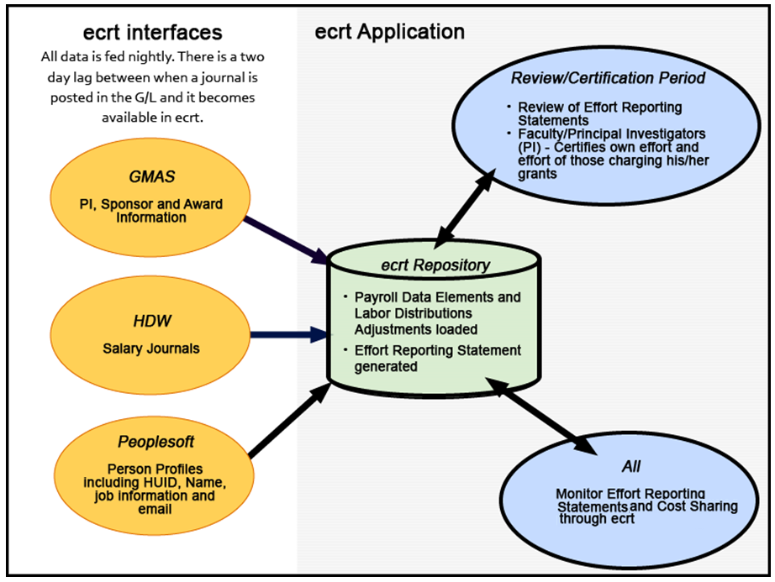
Effort Reporting Lifecycle and Process

Slide 22
ecrt Governance

Slide 23
Salary Object Codes and Certification Mapping

Slide 24
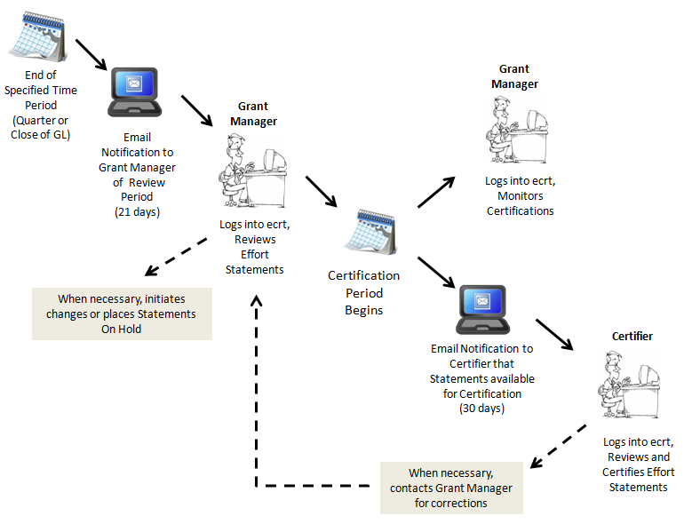
Typical Review/Certification Lifecycle

Slide 25
Icons representing Effort Statement Status
ICON | STATUS DESCRIPTION
 | In Progress**
 | Certified Manually, Pending OSP Review
 | Certified Manually**
 | Certified Manually, Pending Review of Salary Adjustment
 | No Certification Required, Pending OSP Review
 | No Certification Required**
 | No Certification Required, Pending Review of Salary Adjustment
 | Available for Certification**
All statuses apply to Annual Effort Statements, only those with an ** by the description apply to Qtly Project Effort Statements

Slide 26
Icons representing Effort Statement Status (Cont.)
ICON | STATUS DESCRIPTION
 | Multiple Statements, Different Statuses
 | Certified, Pending Grant Manager Review
 | Certified**
 | No Certification Required, Non-Reportable**
 | Certified, Pending Review of Salary Adjustment**
 | Available for Certification, Re-Opened**
 | Available for Certification, Re-Opened by Salary Adjustment**
**Status applies to both Annual Effort Statements, and Quarterly Project Effort Statements

Slide 27
Roles in ecrt
Central Office for Sponsored Programs (OSP) oversees Effort Reporting compliance for University
Structure is typical of a larger department
Role determines which ecrt functions and information you can access, this is tied to your Harvard ID and PIN login

Slide 28
TUB Effort Coordinator
Direct point of contact between TUB and Central.
Responsible for supporting and communicating policy and process changes from Central to TUB.
Contacts Central with any compliance issues or questions.
Facilitates all Effort Reporting for their TUB.
Monitors and manages Effort Reporting
Oversees the local school-level implementation of effort reporting.
Reviews and approves requests for authorized certifier designees for quarterly project effort statements.

Slide 29
Primary (Secondary) Effort Coordinator (PEC/SEC)
Each department has a Primary Effort Coordinator (PEC).
Facilitates all Effort Reporting for their department.
Monitors and manages Effort Reporting for their department.
One or more Secondary Effort Coordinators (SEC) can be identified.
Secondary Effort Coordinators (SEC) serve as a back-up and can perform most of the same functions as Primary Effort Coordinators.
Role determines which ecrt functions and information you can access, this is tied to your Harvard ID and PIN login
Notes:
Within a Tub, each department has a defined primary effort coordinator.
These individuals are responsible for facilitating the effort reporting process in their department, they determine and assign roles for their department effort reporting, and are the main contact for all department effort reporting.
One or More secondary effort coordinators are identified for the department and perform some of the same functions as the primary effort coordinator.
The only difference this person has over an SEC is that they serve as a default person should any certifier not be assigned to a grant manager and SECs do not see all effort tasks for
the department (unless they are also assigned as a GM to some certifiers, they will see the tasks for which they are responsible). In other words, both the SEC and PEC have all of the same functionality in the sense they can manage grant manager assignments and access all information within the org, but the PEC is the default for several emails/statement routing should any assignments get overlooked.

Slide 30
Grant Manager (GM)
Each department has one or more Grant Managers (GM).
Responsible for managing and monitoring the Effort Reporting of their assigned Certifiers (faculty, Principal Investigators, and other academic professionals).
Ultimate responsibility to review the Certification Statements of their assigned Certifiers.
GM ensures that Certification Statements accurately reflect source or sources of funding.
PEC/SEC a responsible for making sure that every certifier is assigned to a grant manager within the system

Slide 31
Certifiers
Faculty, Principal Investigators, and other academic professionals paid in object code 6030 are identified as certifiers within the application.
Certifiers are responsible for confirming or certifying their effort and that of their assigned staff.
If a change or adjustment needs to be made to a statement the Primary Effort Coordinator (PEC) should be notified via email using the Get Help link provided within the system.
Best Recommended Practice: cc: your Grant Manager when using Get Help to send message that corrections are necessary.
Notes:
The certifiers, which includes Faculty, PIs, other academic professionals, and their designees are responsible for confirming or certify their effort statements and their assigned staff in ecrt.
All Certifiers must be assigned to a Grant Manager by the PEC or SEC.

Slide 32
Accessing ecrt
Recommended Browser with ecrt is Firefox
Obtain access through your school’s ecrt Authorized Requestor
Best recommended practice is to bookmark the URL for easy access in the future BEFORE you log in.
https://ecrt.harvard.edu/ecrt/
ecrt contains sensitive data, individuals working in ecrt should follow the guidelines stated in Confidentially Agreement signed in PeopleSoft

Slide 33
Important Reminder-Payroll Data Confidentiality
In accordance with the University’s High Risk Confidential Information policy, it is important to remember that when viewing certification data, payroll percentages as well as dollar amounts may be viewed within the ecrt system.
Grant Managers, Primary and Secondary Effort Coordinators, Tub Effort Coordinators and Central staff are reminded that this data is confidential, and that each staff member annually signs a confidentiality statement for the University. It is expected that these guidelines will be strictly adhered to by anyone granted access to and viewing/working with Annual and Quarterly Effort Certification Statements and reports.
For more information concerning the University’s security policy, please see: http://www.security.harvard.edu/enterprise-security-policy.

